Slide 1

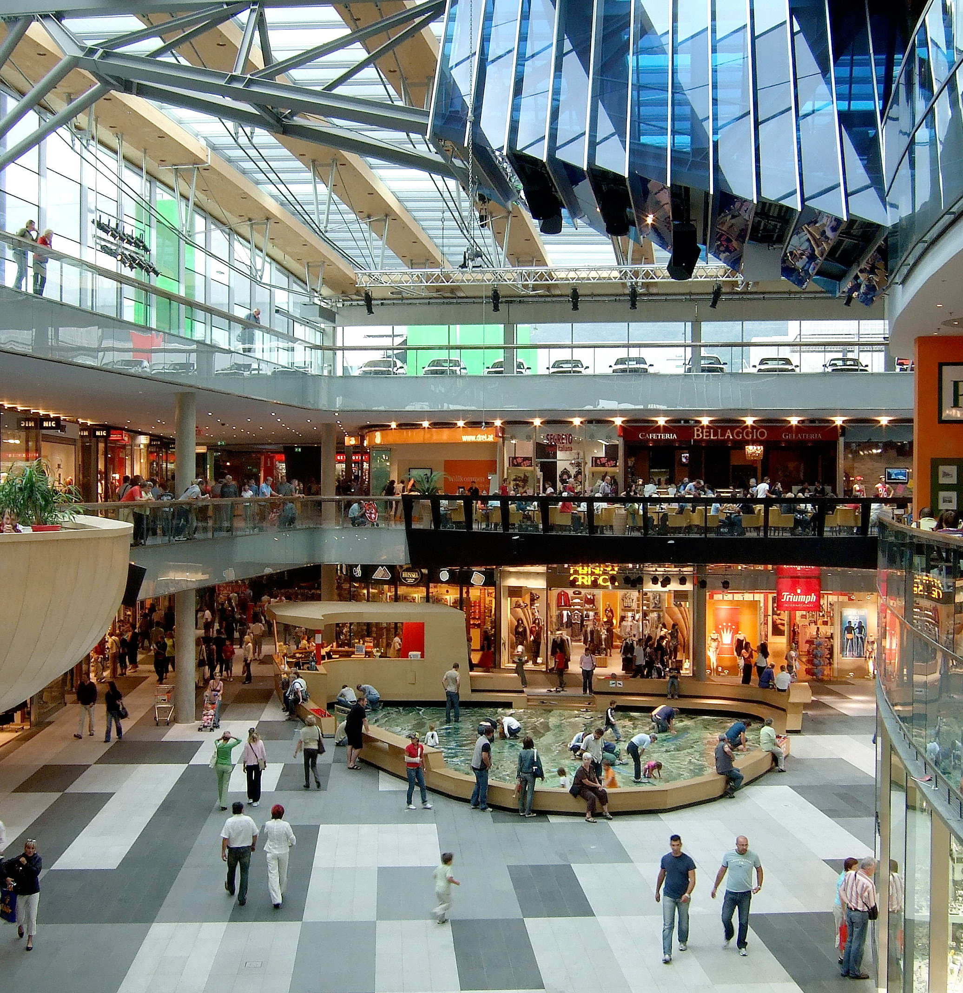
Shopping Mall System Using OOPJ
Prepared By :
Name : Shubh Gandhi
Roll No. : 427 | Batch : C5 | Branch : CSE
Enrollment No. : 21002171210039

Slide 2
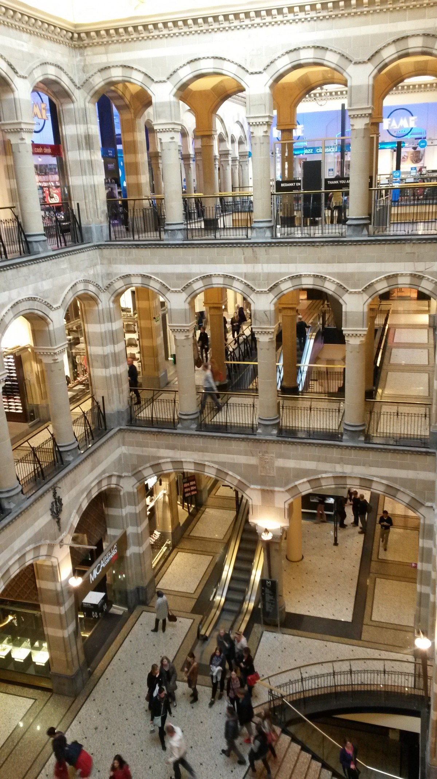
Introduction
The Shopping Mall Management System is a Java-based application designed to improve the shopping experience within a mall.
It features an inventory management system and a user-friendly interface, allowing users to navigate through shops like Reliance Trends, Perfume Hub, Food Plaza, Croma Electronics, and Starbucks Coffee.
Users can select items, view brands, and see associated prices.
The system provides individual shop bills and a combined total bill, ensuring an organized and efficient shopping experience.
This project utilizes object-oriented programming and Java collections for effective functionality.

Slide 3
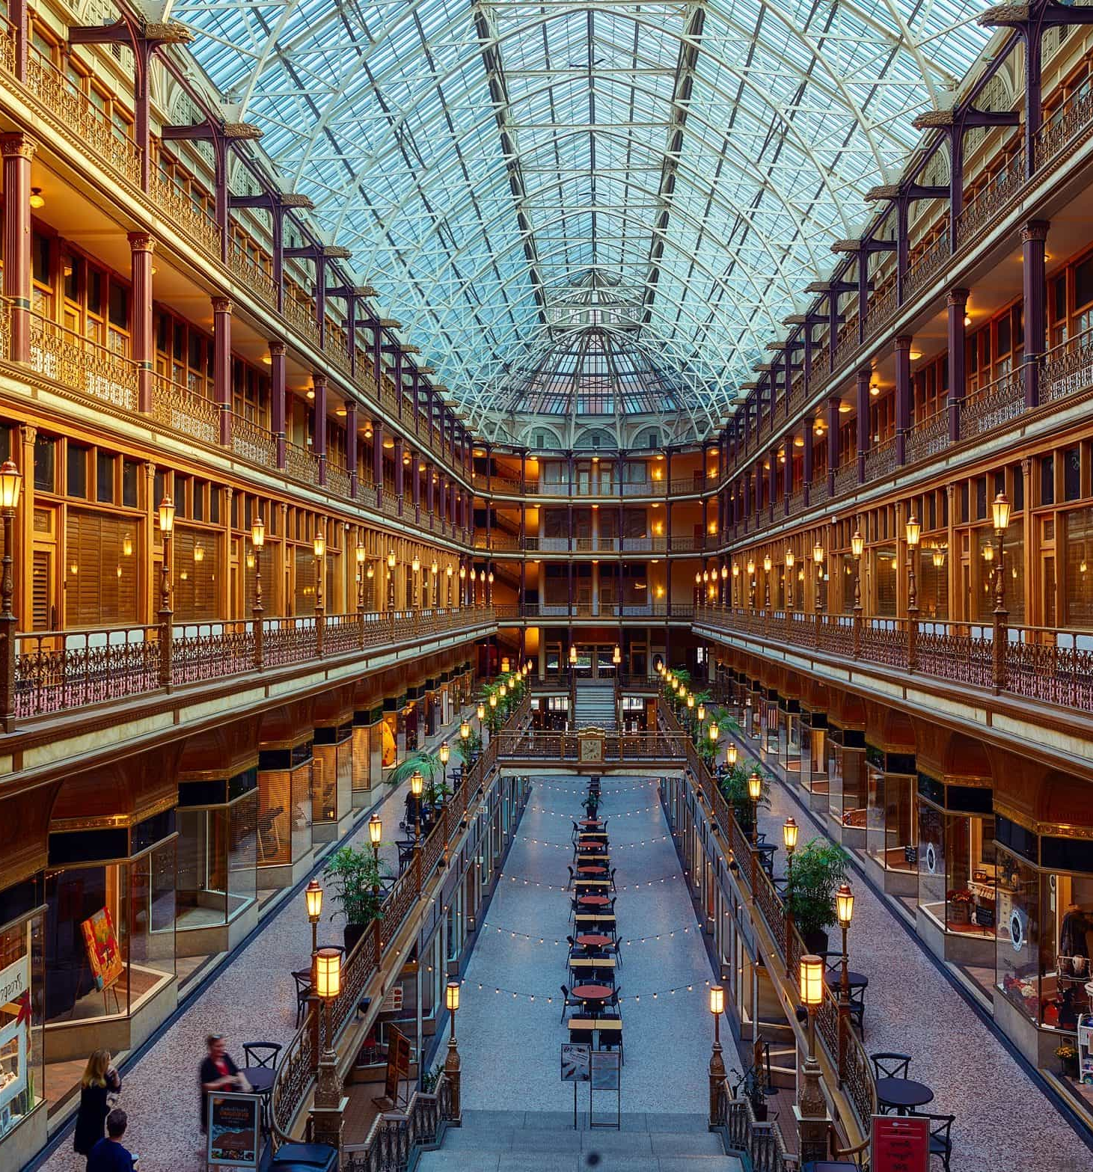
Overall Description
Project Overview: The Shopping Mall Management System is a Java-based application designed to streamline the shopping experience within a mall by managing shops, categories, items, and brands.
Shop Management: Each shop has various item categories, and each category contains items with multiple brands and prices, offering a detailed inventory management solution.
User Navigation: Users can navigate through shops, select item categories, choose items, and view available brands, enhancing their shopping experience.
Billing System: The application provides a detailed billing system that displays the total bill for each shop individually and a combined total bill when requested
Feature Highlights: Key features include item selection, brand selection, individual shop billing, and a combined bill summary, all implemented using Java collections and object-oriented principles

Slide 4
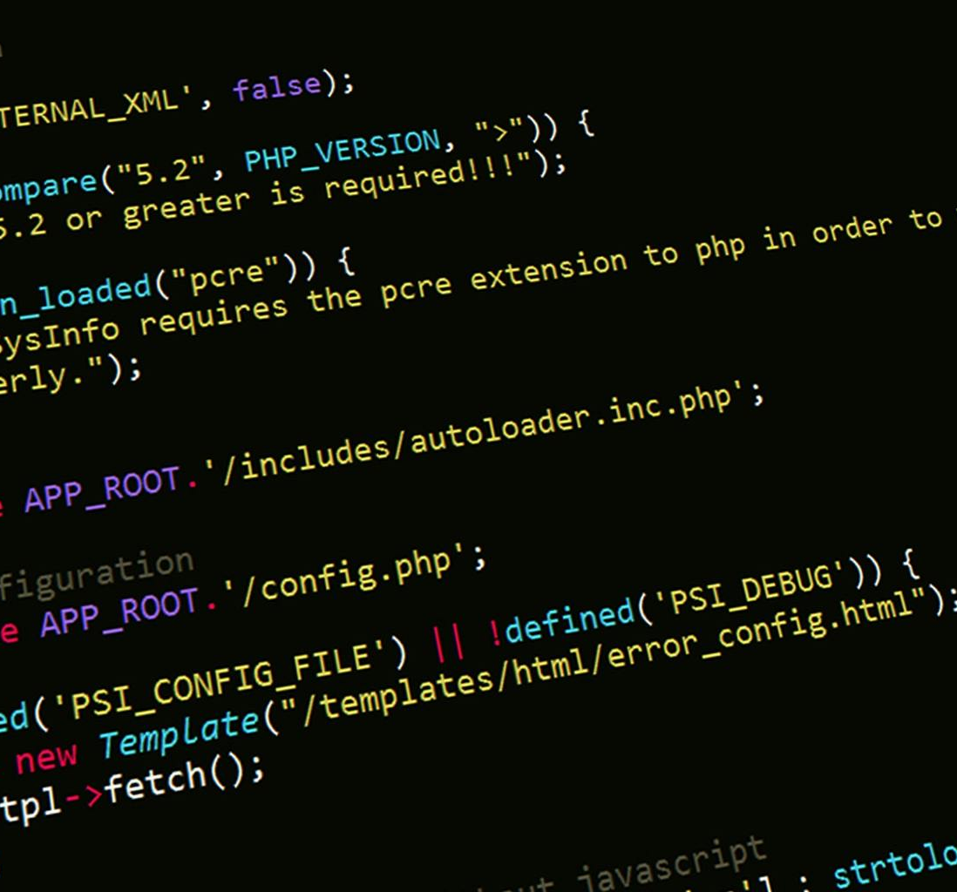
Code Functionality
Class: A blueprint for creating objects. Classes like Shop, ItemCategory, Item, and Brand define the properties and behaviors of various entities in the shopping mall.
Method: A function within a class that describes the actions objects can perform. Examples include addItemCategory and getItemCategories in the Shop class.
Shop Class: Represents a shop in the mall, with attributes like name and item categories, and methods to manage these categories.
ItemCategory Class: Represents categories of items within a shop, containing a list of items and methods to manage them.
Item Class: Represents individual items within a category, holding a list of brands and methods to manage brand details.
Brand Class: Represents item brands, including name and price, with methods to retrieve brand information.
ShoppingMallSystem Class: Manages the shopping mall simulation, including methods for setting up shops, displaying menus, handling item purchases, and displaying total bills.

Slide 5
Scope OF Project
Analytics: Incorporating data analytics and reporting features can help mall management and shop owners track sales trends, inventory levels, and customer preferences for informed business decisions.
Scalability: The system can be expanded to include more shops, item categories, and brands, adapting to a larger shopping mall with diverse offerings.
Integration: Future integration with payment gateways and customer loyalty programs can enhance the functionality, providing seamless transactions and personalized shopping experiences.

Slide 6
Thank You !!
.

